Slide 1


Slide 2



Shefer & Rietveld (1997):
Relation between traffic density, speed and accidents.
High traffic density
High number of accidents
Low traffic density
High severity of accidents

Slide 3
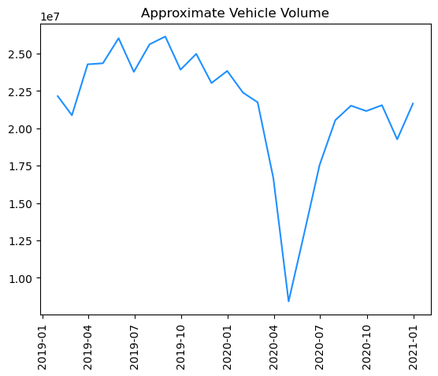
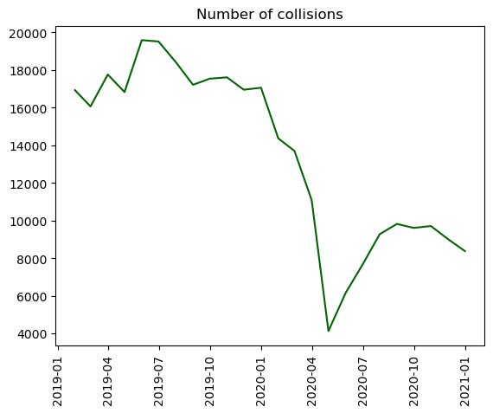

Slide 4
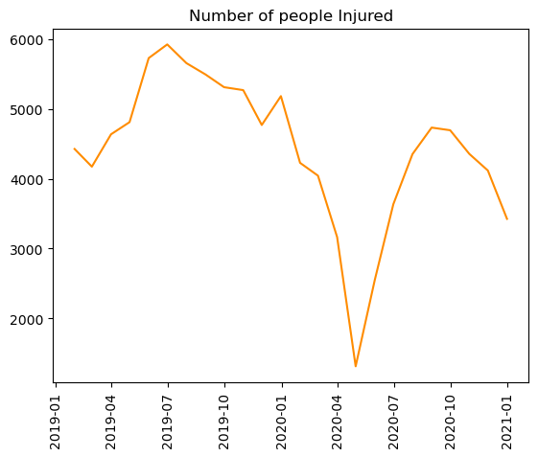
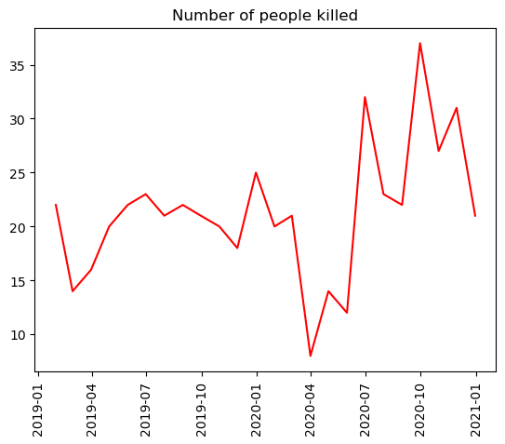

Slide 5
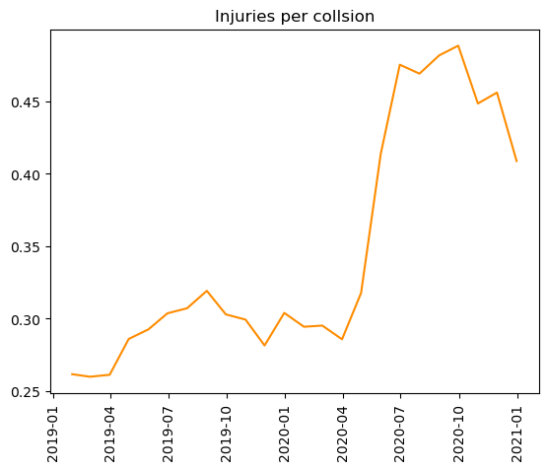
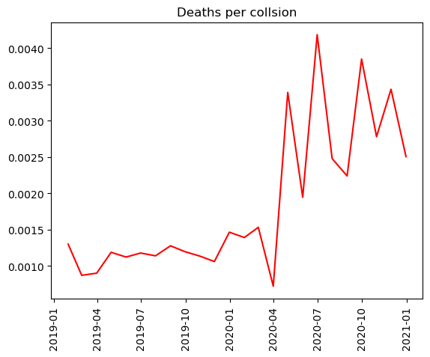
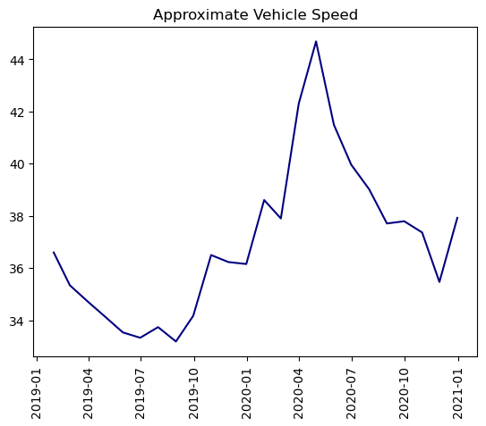

Slide 6

Cappellari & Weber (2022):
Costs associated with traffic accidents in NYC during lockdown.
Value
Property damage : + $ 450,000
Injuries & Deaths : - $ 2,600,000

